Slide 1
Uber Rides
Travel Speeds in Seattle
Authors: Aboli M, Harini R, Mayank G, Samarth M

Slide 2

Introduction
Being frequent Uber riders in Seattle, we were interested in understanding the movement trends of Uber rides on the streets of Seattle.
Uber Movement Speeds is a public dataset provided by Uber which contains anonymized travel data aggregated from their trips for major cities in the US for the year 2018 and 2019.
We have focused on travel speed data of Seattle for the purpose of our analysis.
Notes:
Link to data source: https://movement.uber.com/?lang=en-US

Slide 3
Data Profile
Size: Over 46 million data points in one year, with a size over 15 GB. Due to the huge data size, the initial data procurement and processing was a very time intensive process in this project. We could appreciate the fact that to do any data science, almost 80% of the time needs to be invested in shaping the data correctly.
Granularity: Hourly aggregated data of every Uber ride on the road segment with at least 5 unique trips in that hour.
Relevant Fields: timestamp, year, month, day, and mean speed in mph.
Aggregation: The speed aggregates have been taken by averaging the hourly speeds of Uber rides across different segments of streets in Seattle for the time periods (daily or hourly). This approximation has been chosen due to the lack of availability of other relevant traffic metrics like car counts per street, congestion at different times in a day, type of road (highway or not), type of car, etc.
Notes:
Uber Seattle Travel Speeds: https://movement.uber.com/explore/seattle/speeds/query?dt[tpb]=ALL_DAY&dt[wd;]=1,2,3,4,5,6,7&dt[dr][sd]=2019-12-01&dt[dr][ed]=2019-12-31&ff=&lang=en-US

Slide 4
Caveats
Unavailability of vehicle count on each street to have a weighted average
Unable to map the street IDs (Open Street Map IDs) to the corresponding streets in Seattle
Few missing data points (about 2 days in 2019)
Exclusion of streets travelled by less than 5 cars in an hour
Clipping of the start and end segments of Uber car movements to preserve privacy of riders
Based on Uber’s data collection process, the data can be considered as a randomized sample of the entire population of Uber rides. Thus, the samples as well as the observations within the sample are independent of each other. Additional randomization can be accounted to the environmental factors, type of cars, traffic conditions, locality, etc.

Slide 5
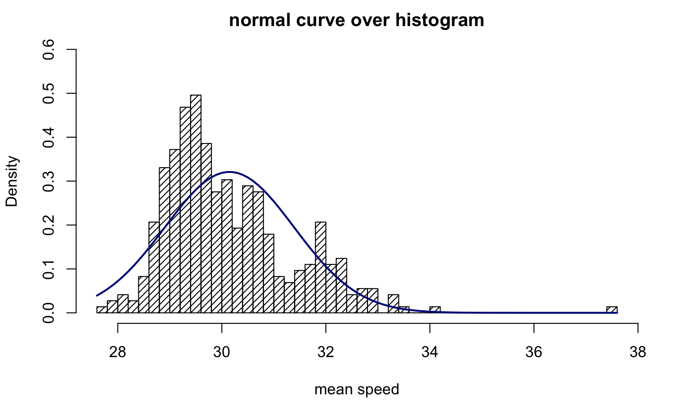
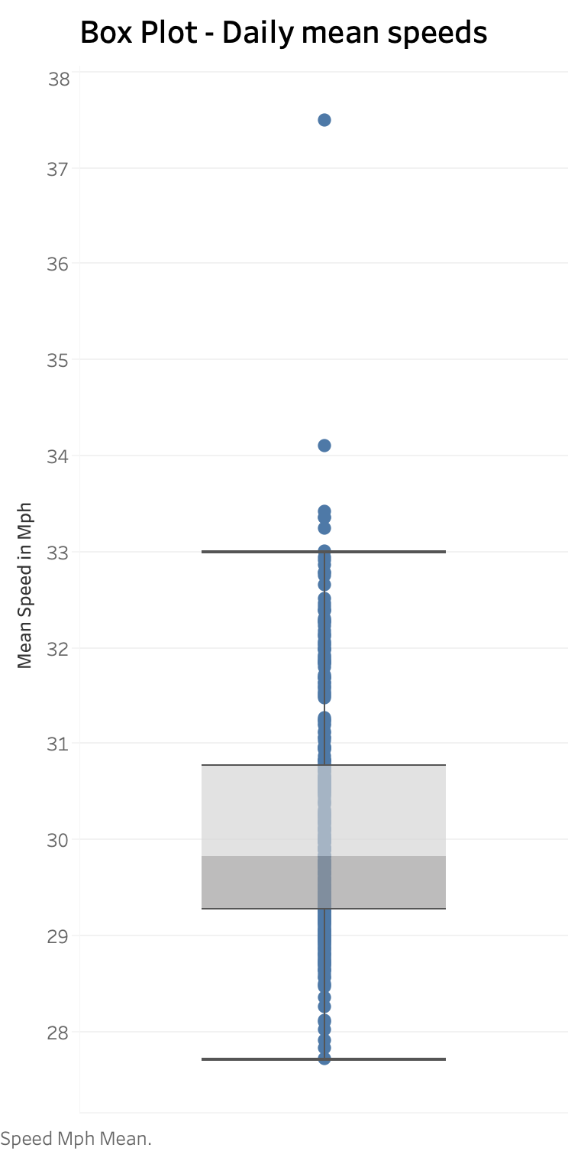
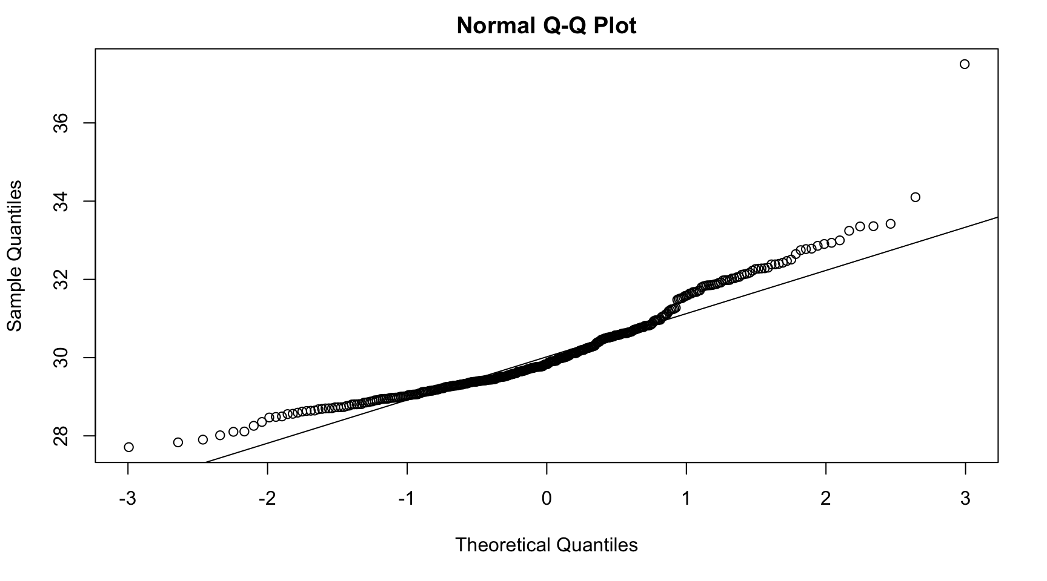
Exploratory
Data Analysis
We observe an approximately normal distribution in the daily average speeds for Uber rides.
Not much variance is observed in the underlying data, with the exception of a few outliers.

Slide 6
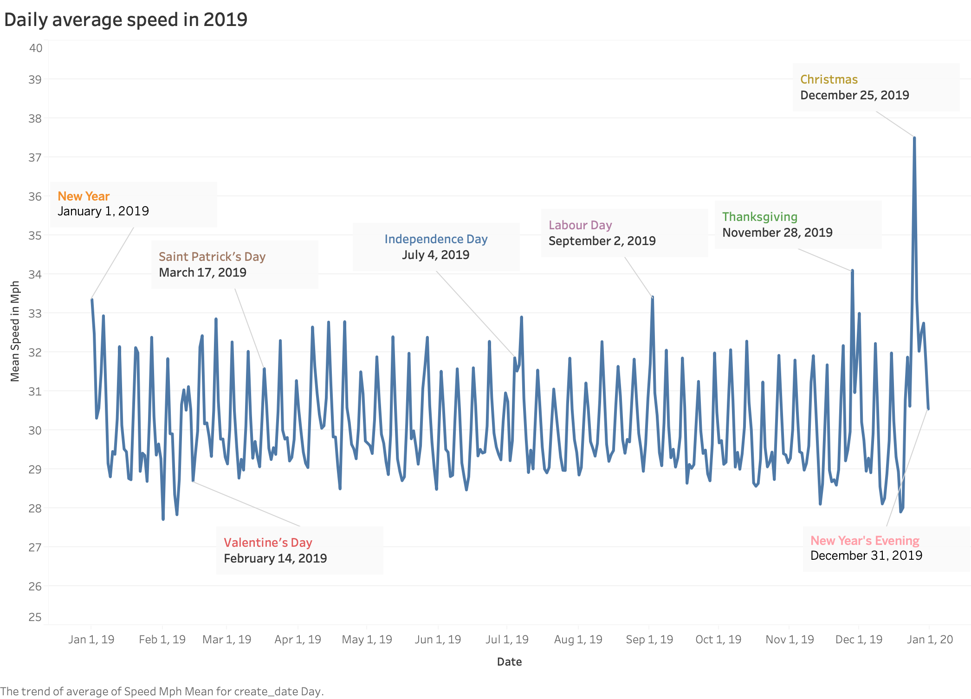
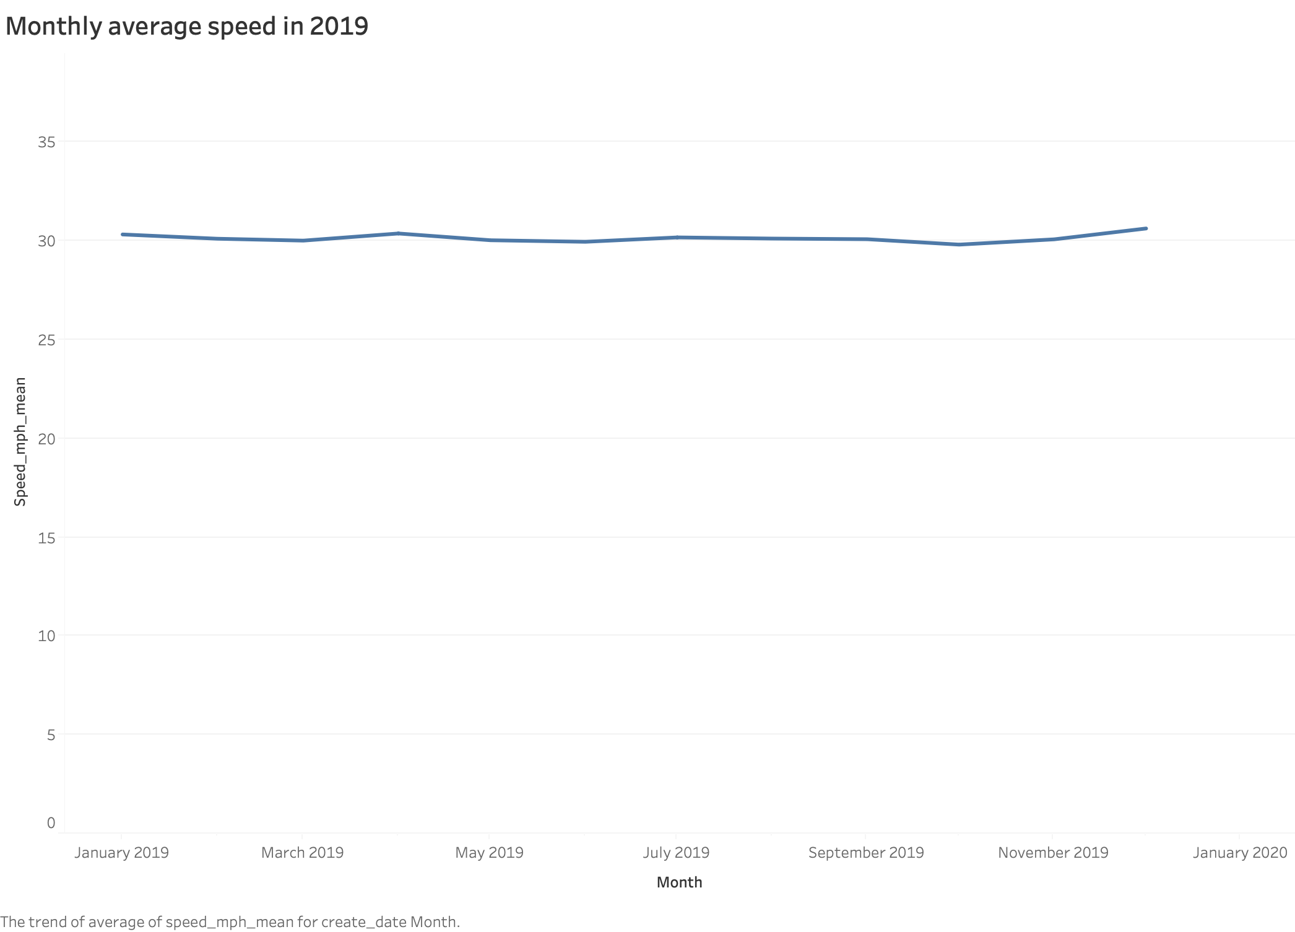
Trends
DAILY AVERAGE SPEED IN 2019
MEAN TRAVEL SPEED IN A YEAR
Mean Speed MPH
MONTHLY AVERAGE SPEED IN 2019
Mean Speed MPH
Date
Note: Y-axis scale has been adjusted for the range to provide magnified view of the trends
Date
Seasonality by the day of the week can be observed
Festive holidays have some deviation from the average

Slide 7
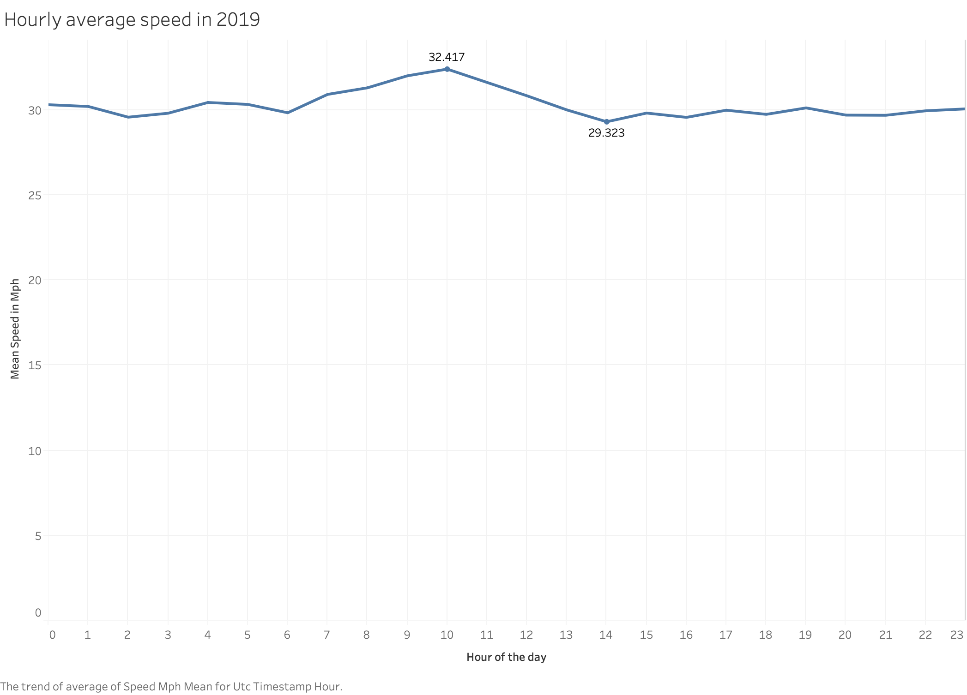
HOURLY AVERAGE SPEED IN 2019
MEAN TRAVEL SPEED IN A DAY
In 2019, mornings (6am to 12pm) tend to have higher average speed
From 2pm till midnight, the average speed remains approximately 30 mph
Mean Speed in Mph
Hour of the day

Slide 8
Areas of Interest
Seasonality by day of week
Impact of popular festivals on speeds
Speeds during peak hours of the day
Target Audience:
Office goers
People moving into Seattle
Students
Uber organisation
Seattle city planning corporation
Seattle police
Anyone curious to understand the Uber movement trends during different times of the day, week and a year

Slide 9

Hypothesis 1
How does the average speed for Uber rides differ on each day of the week in Seattle in 2019?
#MondayBlues
#WeekendVibes
#ThankGodItsFriday
Notes:
Our way of life has lot of factors that may somehow influence the speed of travel, making this hypothesis interesting.
The hypothesis is for each day of the week, not just weekdays.

Slide 10
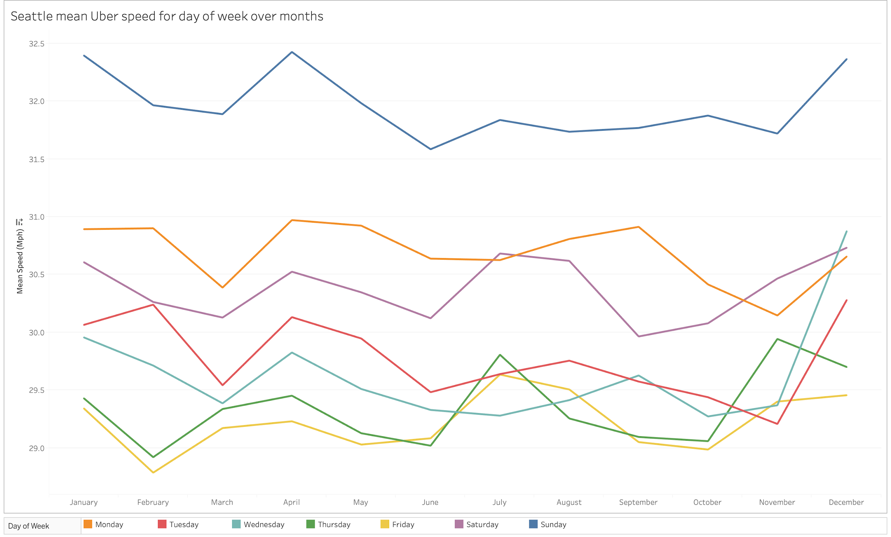
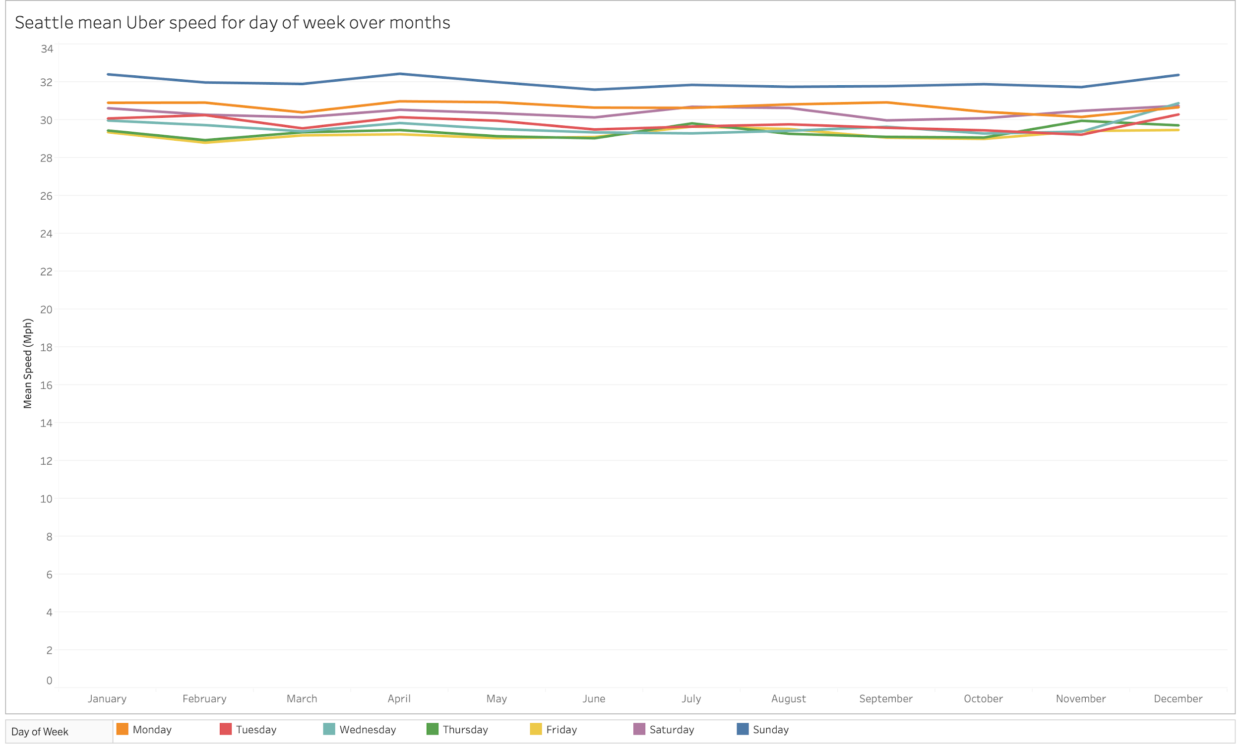
Trends
SEATTLE MEAN UBER SPEED FOR DAY OF WEEK OVER MONTHS
MEAN TRAVEL SPEED OVER MONTHS
Mean Speed MPH
Note: Y-axis scale has been adjusted for the range to provide magnified view of the trends
Sundays are consistently faster around the year
Mondays are surprisingly faster than Saturday and other weekdays
Note: Minified view with Y-axis starting at 0

Slide 11
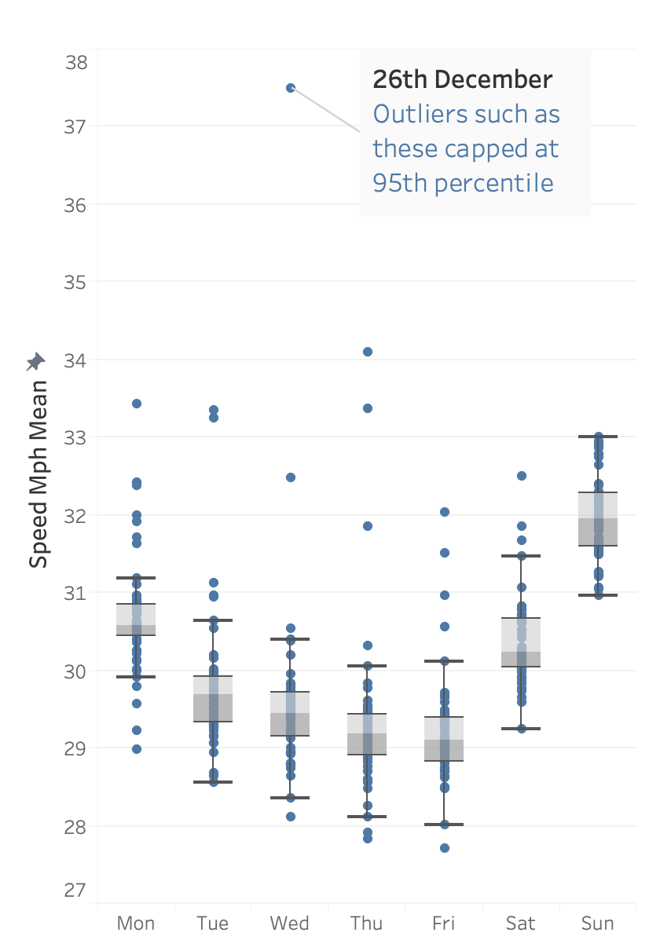
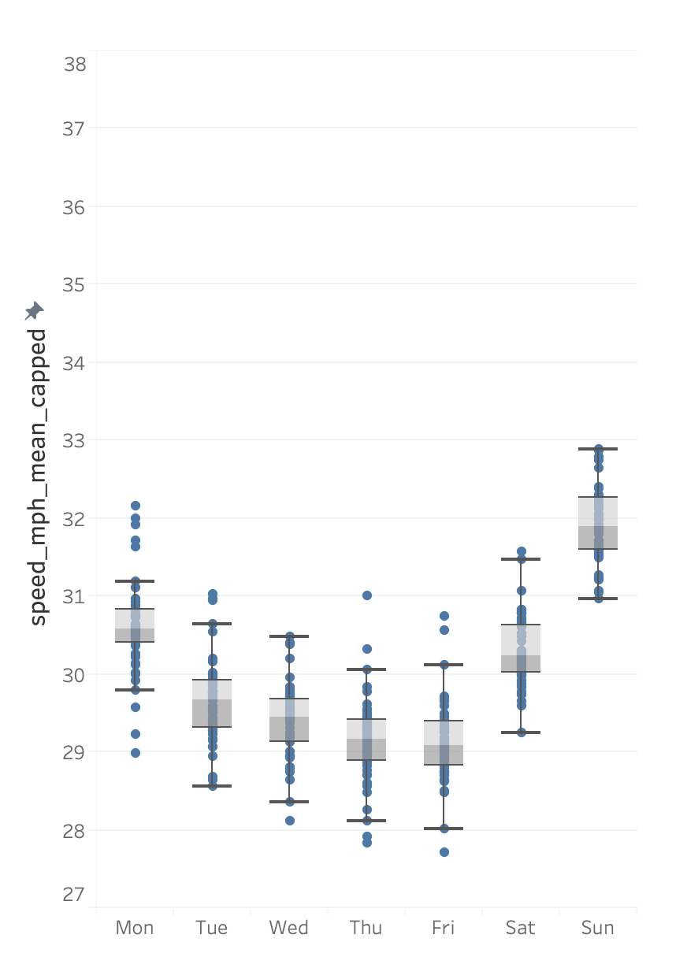
Variance
Original Speeds
Capped Speeds
We noticed some egregious outliers, resulting due to public holidays on weekdays and other miscellaneous factors.
For the purpose of our analysis, we decided to cap such outliers at the 95th percentile of that particular day.
Variance becomes significantly more consistent after outlier treatment

Slide 12
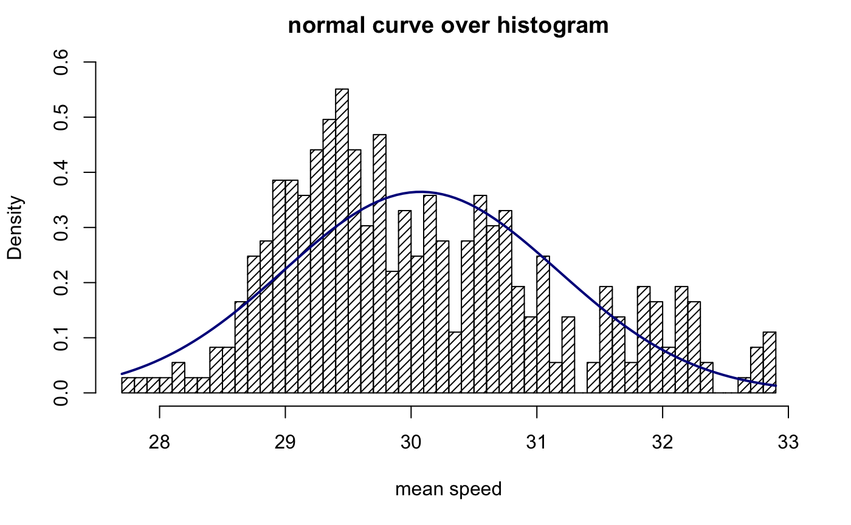
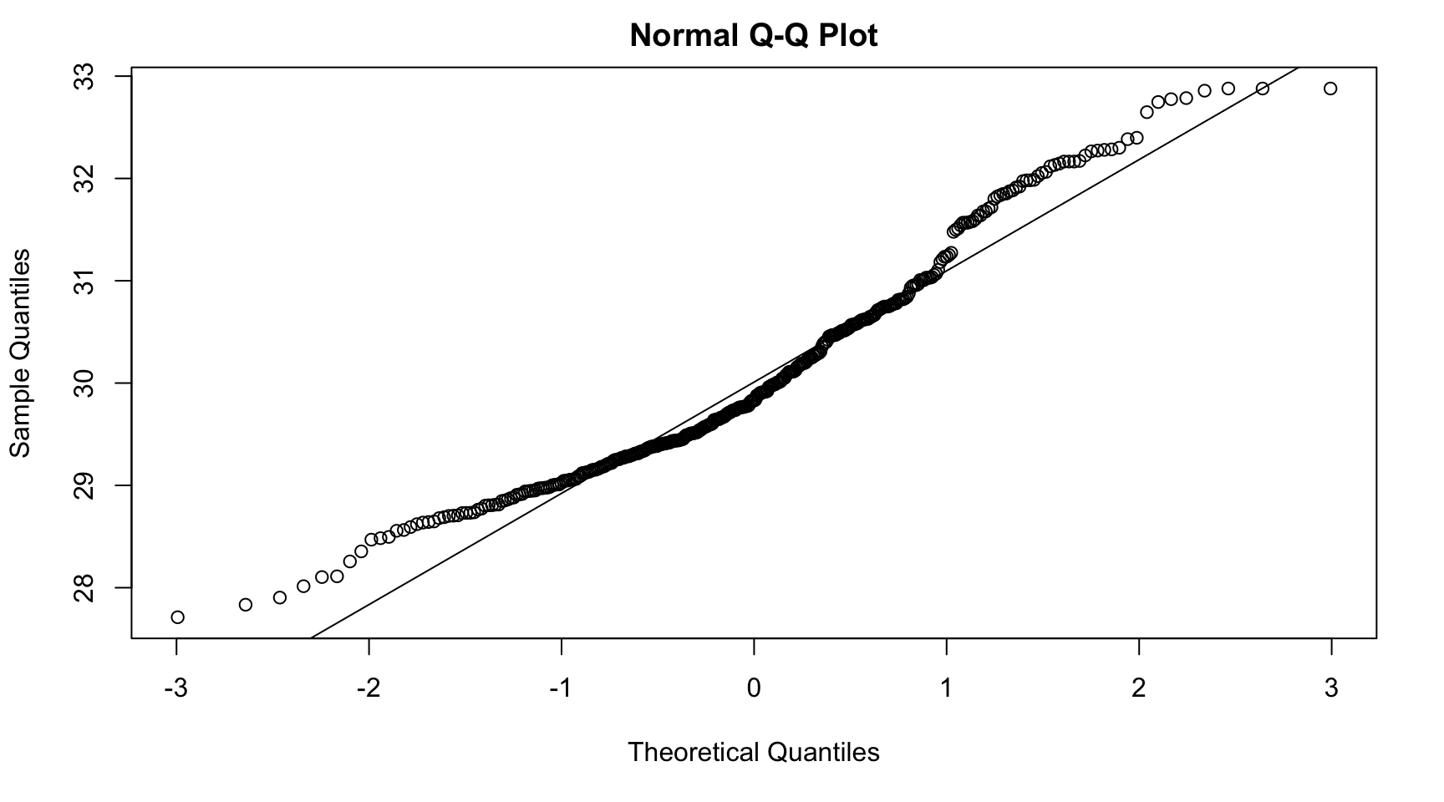
Normality
Histogram and Q-Q plot for population do not offer significant evidence against normal distribution assumption
Note: Both graphs are based on data points obtained after capping outliers at 95th percentile.

Slide 13
Null Hypothesis
The average travel speed for Uber rides was the same for all 7 days of the week in Seattle in 2019.
μ1 = μ2 = μ3 = μ4 = μ5 = μ6 = μ7
where μ1 through μ7 are the average travel speeds for Monday through Sunday respectively for Seattle in 2019.

Slide 14

Hypothesis Testing
METHODOLOGY: Analysis of Variance (ANOVA)
ASSUMPTIONS
Independence
Equal Variance
Large Sample/Normality
OUTCOME
F-STATISTIC = 152.8
P-VALUE = < 2e-16
Df Sum Sq Mean Sq F value Pr(>F)
factor(dayofweek) 6 312.2 52.04 152.8 <2e-16
Residuals 356 121.2 0.34
RESULT: We can reject the null hypothesis at 95% confidence level
Note: R code used for this hypothesis testing can be found in Appendix 1.

Slide 15
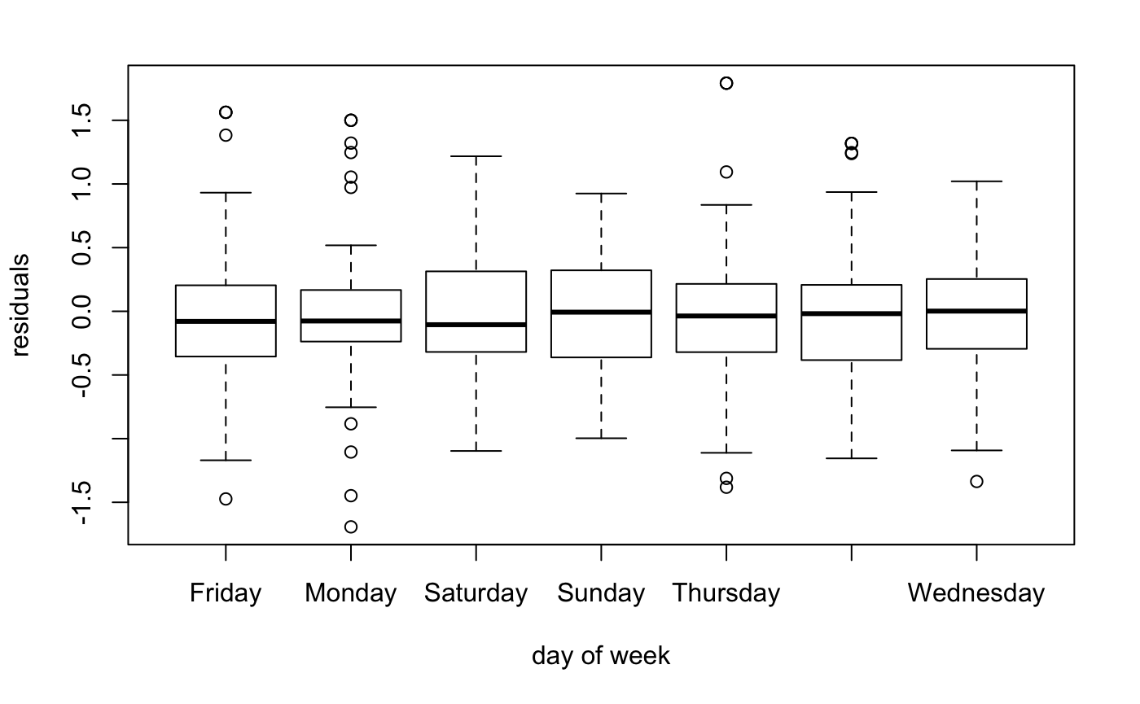
Residual Diagnostic
RESIDUAL DIAGNOSTIC FOR EQUALITY OF VARIANCE
Our equality of variance assumption was further corroborated by the boxplot showing variances of the residual for all 7 groups
The plot can be interpreted as indicating no evidence against equality of variances.

Slide 16
Inferences
We can infer that mean speed for Uber rides in Seattle in 2019 is not same for each day of the week. This is in agreement with our results from descriptive statistics and trends analysis. Important to note that mean speed is taken across streets without accounting for number of cars.
To drill down further, we also performed ANOVA test by grouping days as weekdays vs weekends. This test (F-stat: 229.3, p-value: < 2e-16) also gave us a similar conclusion that mean speed is not the same for different days of the week.
Possible Explanation: The result is intuitive and seems logical as traffic is highly influenced by work commute, which affects the mean speed on working days, but not on weekends. It can further be influenced by factors such as employees working from home, different office timings for Fridays, people going out on Saturday evenings etc.

Slide 17


Hypothesis 2
Is the average travel speed for Uber rides comparable during the different festive times in Seattle?
We would like to compare the 2 most popular holidays in Seattle for this analysis:
Thanksgiving vs. Christmas

Slide 18
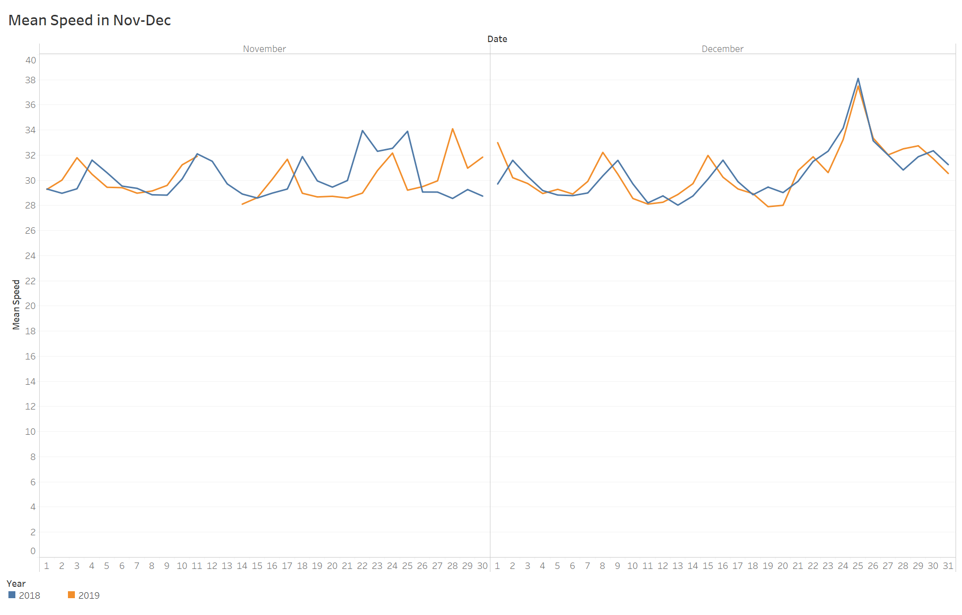
Trends
MEAN DAILY SPEEDS IN NOV - DEC
November
December
Mean speed is higher on days of Thanksgiving and Christmas compared to other days.
This observation made us curious to test if there is a significant difference between speeds during the 2 festive holiday periods.
Christmas
25-Dec-2018
Mean Speed: 38.24
Thanksgiving
28-Nov-2019
Mean Speed: 34.12
Mean Speed MPH
Christmas
25-Dec-2019
Mean Speed: 37.19
Thanksgiving
22-Nov-2018
Mean Speed: 34.02
Day of month

Slide 19
Dataset
Prior Weekend
Day of Festival
Following
Weekend
FESTIVE PERIOD
The sample size for both groups in this case is very small and comparable to each other.
We wanted one of our hypotheses to be on a small size dataset to understand how testing can be applied in a constrained real-life setting.
OR
Thanksgiving: 10 Days
In 2018: Wed, 21 Nov to Sun, 25 Nov
In 2019: Wed, 27 Nov to Sun, 01 Dec
Christmas: 11 Days
In 2018: Sat, 22 Dec to Wed, 26 Dec
In 2019: Tue, 24 Dec to Sun, 29 Dec
Notes:
For this analysis, we considered the actual day of the festival, one day prior to the festival as well as the nearest weekend days. This has been done to account for the holiday period when people take time off to celebrate.

Slide 20
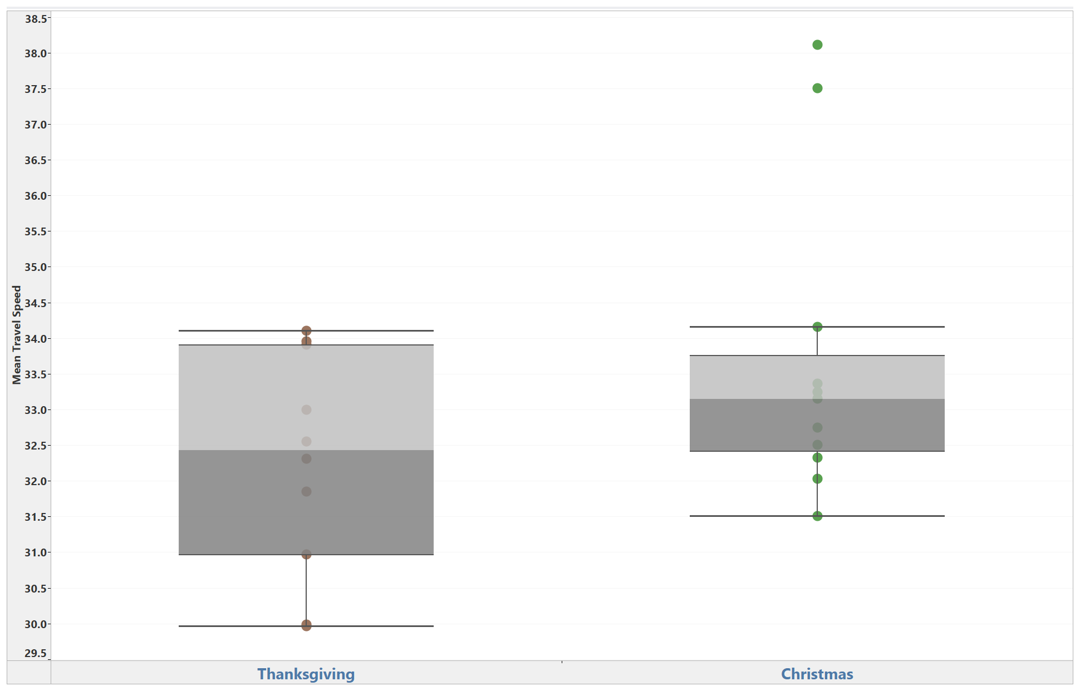
Descriptive Statistics
MEAN TRAVEL SPEED
MEAN TRAVEL SPEEDS
Mean Speed | Thanksgiving | Christmas
Min. | 29.96 | 31.51
1st Qu. | 31.19 | 32.41
Median | 32.43 | 33.15
Mean | 32.26 | 33.69
3rd Qu. | 33.68 | 33.76
Max. | 34.1 | 38.11
Std Deviation | 1.56 | 2.16
Variance | 2.43 | 4.66
Datapoints | 10 | 11
Thanksgiving
Christmas
The variances of the 2 groups are unequal but the mean speeds are quite similar.
Christmas period shows higher variance in mean speeds as compared to Thanksgiving period.

Slide 21
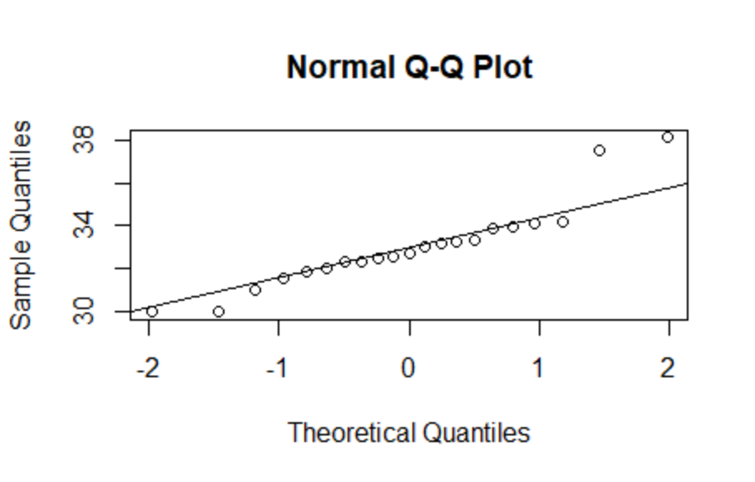
Normality
Earlier, we have earlier observed that the population follows a normal distribution.
Here we can observe that the sampled data for the festivals also follows a normal distribution with the exception of a few outliers.
Refer appendix for R code to generate this plot.

Slide 22
Null Hypothesis
The average travel speed for Uber rides was the same for both festive periods around Christmas and Thanksgiving in Seattle in 2018 and 2019.
μ1 = μ2
where μ1 and μ2 are the average travel speeds for the selected Thanksgiving days and Christmas days in Seattle for 2018 and 2019.

Slide 23
Hypothesis Testing
METHODOLOGY: Welch Test (Unequal variance t-test)
Refer Appendix for R Code
CHECKS
Independence
Unequal Variance
Normality
Small Sample Sizes
OUTCOME
T-Statistic = -1.7572, Df = 18.138, P-Value = 0.09547
Power = 41.5% (Effect size = 1.43)
Desired Sample Size for 80% Power = 27 per group
Data: Thanksgiving and Christmas
Alternative hypothesis: true difference in means is not equal to 0
95 percent confidence interval: (-3.1502962 0.2797746)
Sample of estimates:
Mean of x: 32.25829, Mean of y: 33.69355
RESULT: P-value > 0.05, not enough evidence to reject the Null Hypothesis of equal means
Notes:
For the Welch test, we got power as 41.5% due to a small sample size (10 per group). To obtain 80% power, we would require at least 27 samples per group. To obtain 90% power, we would require at least 36 samples per group. Uber does not provide this much data and hence this result should be interpreted with more caution.

Slide 24
Hypothesis Testing
Very low power (41.5%) due to a small sample size (10 per group)
Desired sample sizes:
80% power → 27 samples per group
90% power → 36 samples per group
Uber does not provide this much data and hence this result should be interpreted with more caution.
METHODOLOGY: Welch Test (Unequal variance t-test)
Refer Appendix for R Code
CHECKS
Independence
Unequal Variance
Normality
Small Sample Sizes
OUTCOME
T-Statistic = -1.7572, Df = 18.138, P-Value = 0.09547
Power = 41.5% (Effect size = 1.43)
Desired Sample Size for 80% Power = 27 per group
Data: Thanksgiving and Christmas
Alternative hypothesis: true difference in means is not equal to 0
95 percent confidence interval: (-3.1502962 0.2797746)
Sample of estimates:
Mean of x: 32.25829, Mean of y: 33.69355
RESULT: P-value > 0.05, not enough evidence to reject the Null Hypothesis of equal means

Slide 25
Inference
Caveat: Due to very low power to detect differences in means as well as some deviation from normality, we should not draw very strong conclusions based on this test result.
As per our test results, we cannot say with confidence that the mean travel speeds were different for Christmas and Thanksgiving in Seattle during 2018 and 2019.
As per our descriptive statistics, we observed that the mean speeds were quite similar for these 2 festive periods.
We also tested this Null Hypothesis using the equal variance t-test as the variances were not drastically different from each other (if not identical) and obtained similar results (p-value > 0.05)
Possible Reasons: These festivals are known to be celebrated indoors and people may travel intermittently to reach their destinations.

Slide 26


Hypothesis 3
How did travel speed differ for Uber rides on weekdays during the peak hours of the morning vs. peak hours of the evening in Seattle in the year 2019?
Morning Peak Hours vs. Evening Peak Hours
8 am to 11 am vs. 5 pm to 8 pm

Slide 27
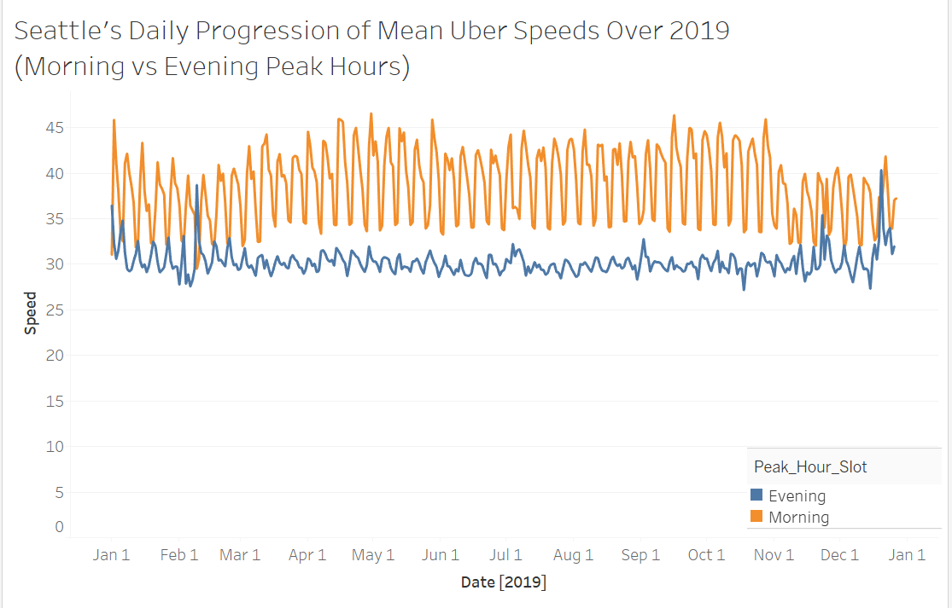
Trends
MEAN DAILY SPEEDS FOR MORNING VS EVENING PEAK HOURS (2019)
Summary | Morning | Evening
Min. | 31.02 | 27.30
Mean | 40.68 | 30.05
Max. | 46.57 | 40.33
Std Deviation | 2.75 | 1.22
Variance | 7.56 | 1.51
Datapoints | 771 | 771
Much larger variance in morning peak hour speeds than in evening peak hours
Mean speeds: Morning > Evening
Sample size is relatively large and comparable

Slide 28
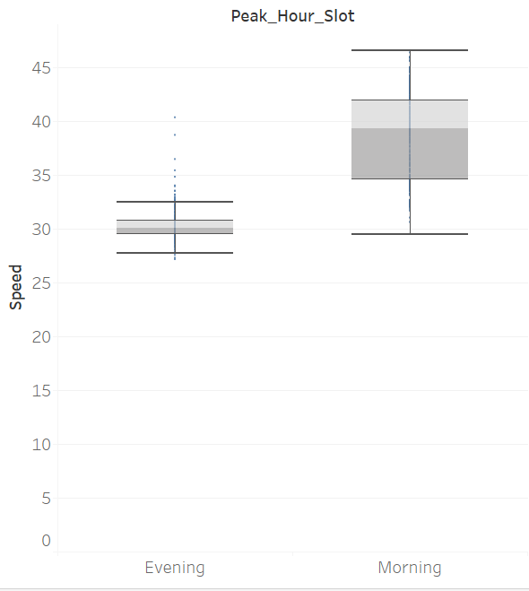
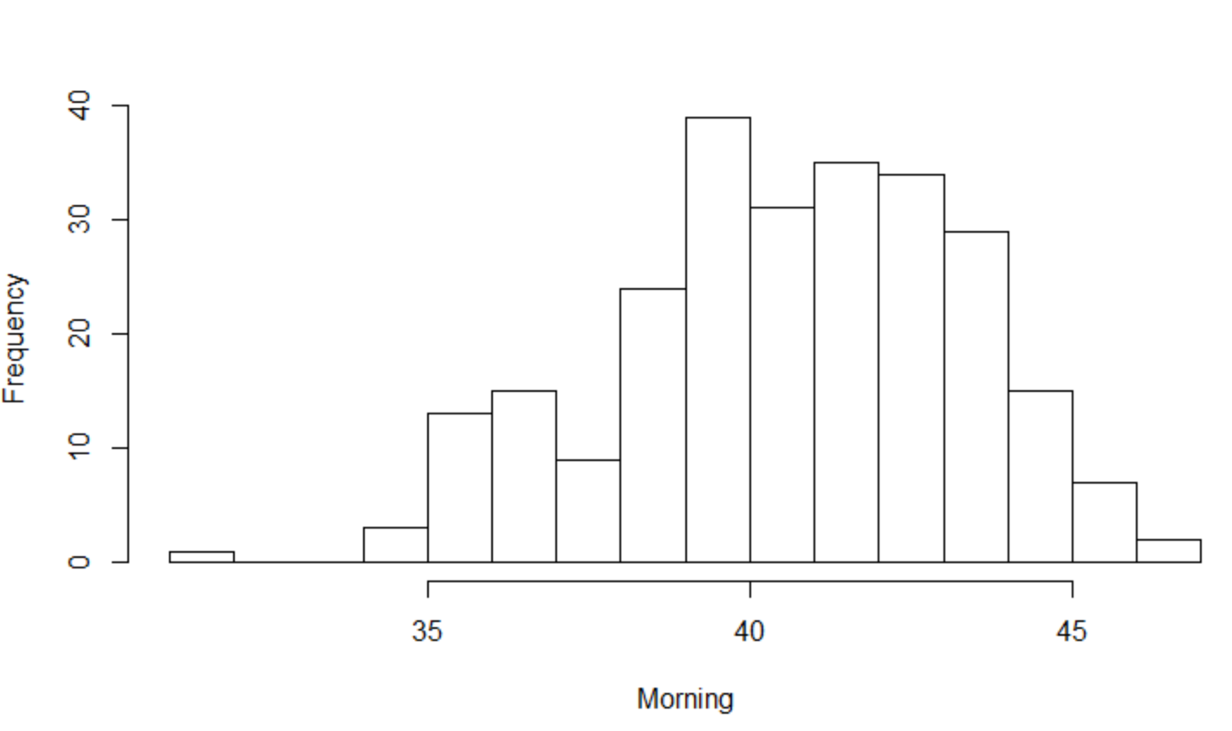
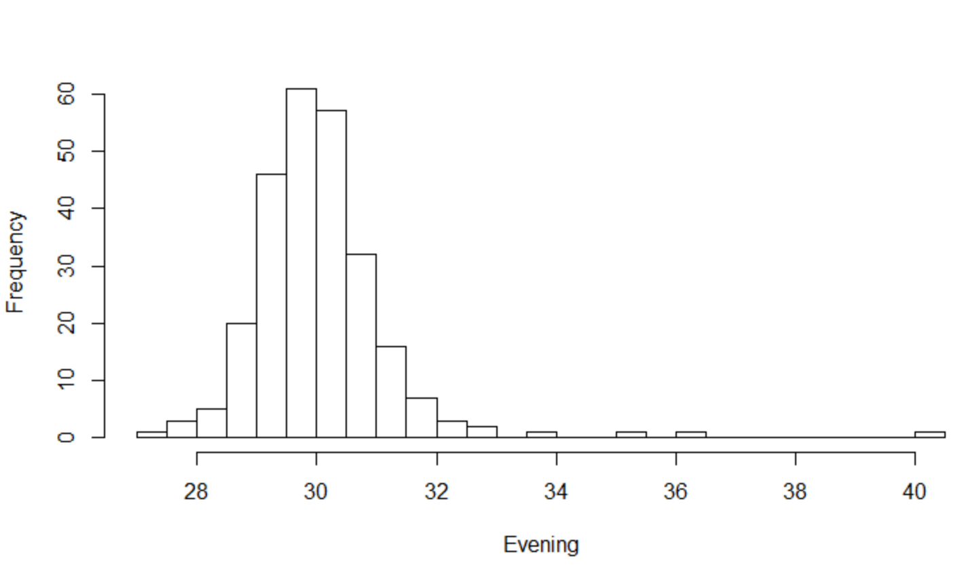
Data Distribution
MEAN SPEED - MORNING PEAK HOURS
Frequency
Morning Mean Speed
MEAN SPEED - EVENING PEAK HOURS
Frequency
The morning distribution looks slightly right skewed with greater variance whereas the evening distribution looks slightly left skewed
Evening Mean Speed

Slide 29
Null Hypothesis
The average travel speed for Uber rides is the same on weekdays for both morning and evening peak hours in Seattle across 2019.
μ1 = μ2
where μ1 and μ2 are the average travel speeds for morning and evening peak hours for weekdays in Seattle for 2019.

Slide 30
Hypothesis Testing
METHODOLOGY: Large sample z-test (one-sided)
Refer Appendix for R Code
ASSUMPTIONS
Independence
Large Sample/Normality
OUTCOME
Z-STATISTIC = 60.00924
Compare against: Critical Z-Value 1.64 for 1-tail distribution at 0.05 significance level
P-VALUE < 2e-16
POWER > 99% (Effect Size = 10.63, Sample Size = 771 per group)
RESULT: P-value < 0.05, Reject the Null Hypothesis of equal means with 95% confidence.
Notes:
Since the sample sizes are large, non-normality of the data does not matter.

Slide 31
Inference
We can say with 95% confidence that the mean travel speeds are greater on weekdays for mornings as compared to evening peak hours in Seattle during 2019.
This is also supported by our descriptive statistics where we examined that the mean speeds for the morning peak hours was greater than evening peak hours.
We also tested this Null Hypothesis using the Welch test by simulating small samples of size 50 from the large sample and obtained the same conclusion of p-value < 0.05.
Possible Explanation: One possible reason for the difference in mean speeds could be because working professionals could be rushing to get to work early. This would explain the mean speeds in the morning being greater than in the evenings. Additionally, in the morning, there is likely only office traffic. But during evening peak hours, there could be many more reasons for congestion (eg: outings, social activity). This could be another reason as to why evening peak hours’ mean speeds may be lower.

Slide 32
Extended Inferences
The high level trends observed in Uber’s movements could possibly be extrapolated to other automobile movements in Seattle.
However, the mean speeds between Uber vehicles and other vehicles in Seattle might differ due to various factors such as:
Uber drivers need to follow a speed limit and driving rules
Car condition of Uber vehicles is monitored
Car type of Uber vehicles is usually Sedans, Hatchbacks and SUVs. This is not representative of other vehicles such as pickup trucks, buses, motorbikes in Seattle.
Localities in which Uber might be providing services is not representative of the entire Seattle area
Hence we recommend that these observations and inferences should be restricted only to interpret Uber rides in Seattle.

Slide 33
THANK YOU!
QUESTIONS?

Slide 34
Appendix

Slide 35
Appendix: R Codes for Analysis

Slide 36
Hypothesis 1 (Days of Week)
Code for outlier treatment
library(tidyverse)
remove_outliers <- function(x) {
quantiles <- quantile(x, c(0, .95 ) )
y = x
y[ y > quantiles[2] ] <- quantiles[2]
y
}
add_new_column <- function(df) {
speed_mph_mean_capped <- remove_outliers(df$speed_mph_mean)
return(cbind(speed_mph_mean_capped,df))
}
dfnew <- df %>%
group_by(dayofweek) %>%
nest() %>%
mutate(data = map(data, add_new_column)) %>%
unnest()
Code for ANOVA test
fit = aov(speed_mph_mean_capped~factor(dayofweek),df)
summary(fit)
Code for residual check
residuals <- resid(fit)
boxplot(residuals ~ df$dayofweek, xlab = "day of week")

Slide 37
Hypothesis 2 (Festivals)
Code for Welch Test
Thanksgiving <- all_thnx_data$mean_speed
Christmas <- all_xmas_data$mean_speed
t.test(Thanksgiving, Christmas, var.equal = FALSE)
qqplot(y=all_xmas_data$mean_speed)
Code for ANOVA
summary(aov(mean_speed ~ factor(flag), data=all_festival_data))
Code for Equal Variance T-test
t.test(all_thnx_data$mean_speed, all_xmas_data$mean_speed, var.equal = TRUE)

Slide 38
Hypothesis 3 (Peak Hours)
Code for Z-test
s1=sd(morning$mean_speed)
s2=sd(evening$mean_speed)
n1=length(morning$mean_speed)
n2=length(evening$mean_speed)
Morning=morning$mean_speed
Evening=evening$mean_speed
X=mean(Morning)-mean(Evening)
mu0=0
se=sqrt(((s1*s1)/n1)+((s2*s2)/n2))
zstat=((X-mu0)/se)
data.frame(zstat,p=round((1-pnorm(zstat)),4))
Code for Welch test (simulation)
set.seed(123456)
reps=20000
z=rep(NA,reps)
tstat=c(reps)
n1=50
n2=50
for(i in 1:reps)
{
morning_sample=sample_n(morning,50,replace=TRUE)
evening_sample=sample_n(evening,50,replace=TRUE) tstat[i]=t.test(morning_sample,evening_sample,alternative="less",mu=0,var.equal=F)$statistic
}
welch.df = (s1^2/n1 + s2^2/n2)^2/
(s1^4/(n1^2*(n1-1)) + s2^4/(n2^2*(n2-1)))
mean(abs(tstat)>qt(.975,welch.df))

Slide 39
Power Calculations and Sample Size
Power Calculation
alpha = 0.05 #significance level
n = nrow(total)/2 #sample size for each group
ma = mean(morning$mean_speed)
mb = mean(evening$mean_speed)
sa = sd(morning$mean_speed)
sb = sd(evening$mean_speed)
delta = ma - mb #difference between true means
t1 = -qnorm(1-(alpha/2))
t2 = abs(delta)/sqrt((sa*sa/n) + (sb*sb/n))
tf = t1 + t2
power = 100*pnorm(tf) #power
print(power)
Sample Size Calculation
# Desired Sample Size (80% Power)
beta = 1-0.80 #type 2 error probability
n <- ((sa^2 + sb^2)*(qnorm(1-beta)+qnorm(1-alpha/2))^2)/(delta^2)
n <- round(n,0)
print(n) #Desired sample size
# Desired Sample Size (90% Power)
beta = 1-0.90 #type 2 error probability
n <- ((sa^2 + sb^2)*(qnorm(1-beta)+qnorm(1-alpha/2))^2)/(delta^2)
n <- round(n,0)
print(n) #Desired sample size

Slide 40
Descriptive Statistics
Histogram
g = df$speed_mph_mean
m<-mean(g)
std<-sqrt(var(g))
hist(g, density=20, breaks=40, prob=TRUE,
xlab="mean speed", ylim=c(0, 0.6),
main="normal curve over histogram")
curve(dnorm(x, mean=m, sd=std),
col="darkblue", lwd=2, add=TRUE, yaxt="n")
```
Box Plot
boxplot(df$speed_mph_mean_capped~df$dayofweek)
QQ Plot
qqnorm(df$speed_mph_mean)
qqline(df$speed_mph_mean)

Slide 41
Appendix: Data Details

Slide 42
Day of Week Dataset
Snapshot of the aggregated dataset for this hypothesis
Note: These averages have been taken by averaging the hourly speeds of Uber rides across different segments of streets in Seattle for the selected dates. This approximation has been chosen due to the lack of availability of other relevant traffic metrics like car counts per street, congestion at different times in a day, type of road (highway or not), type of car, etc.
Year | Month | Day | Day Of Week | Mean Speed (mph)
2019 | 1 | 1 | Tuesday | 33.35249
2019 | 1 | 2 | Wednesday | 32.47098
2019 | 1 | 3 | Thursday | 30.30966
... | ... | ... | ... | ...
2019 | 12 | 31 | Tuesday | 30.54495
Data Summary (Mean Speed)
Mean 30.15
SD 1.24
Var 1.54
Min 27.71
Max 37.50

Slide 43
Day of Week Descriptive Statistics
Notice the change in variances between uncapped and capped data points. As variances for capped data are much closer to each other and are also relatively low compared to the mean, we felt confident in assuming equality of variance.
Day of week | Mean | Var (uncapped) | Var (capped) | Min | Max | Sample size
Monday | 30.66488 | 0.5808846 | 0.4467365 | 28.97204 | 32.16502 | 52
Tuesday | 29.71113 | 0.7862165 | 0.3533132 | 28.55620 | 31.02958 | 52
Wednesday | 29.44743 | 1.6810621 | 0.2717846 | 28.11119 | 30.46823 | 51
Thursday | 29.21528 | 1.1641402 | 0.4258321 | 27.83370 | 31.00691 | 52
Friday | 29.18465 | 0.5453930 | 0.3635415 | 27.71119 | 30.74745 | 52
Saturday | 30.34955 | 0.3365615 | 0.2547196 | 29.25290 | 31.56715 | 52
Sunday | 31.95395 | 0.2739123 | 0.2662607 | 30.95696 | 32.87888 | 52

Slide 44
Festival Dataset Snapshot
A snapshot of the filtered and aggregated dataset prepared for this hypothesis
Note: The speed aggregates have been taken by averaging the hourly speeds of Uber rides across different segments of streets in Seattle for the selected dates. This approximation has been chosen due to the lack of availability of other relevant traffic metrics like car counts per street, congestion at different times in a day, type of road (highway or not), type of car, etc.
Year | Month | Day | Festival | Mean Speed (mph)
2018 | 11 | 21 | Thanksgiving | 29.98616
2018 | 11 | 22 | Thanksgiving | 33.95708
2018 | 11 | 23 | Thanksgiving | 32.31070
... | ... | ... | ... | ...
2019 | 12 | 29 | Christmas | 32.74694

Slide 45
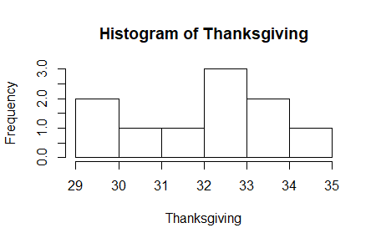
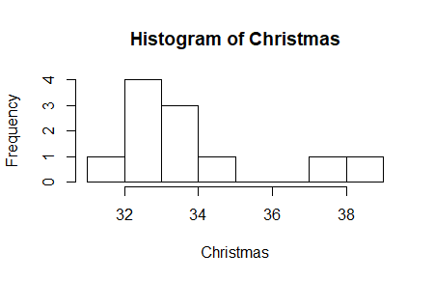
Festival Data Distributions
MEAN SPEED DURING THANKSGIVING
MEAN SPEED DURING CHRISTMAS
Due to very small sample sizes, it is difficult to determine the distribution for the 2 groups.
However, the distribution of the underlying population is normal (Refer)

Slide 46
Peak Hours Dataset
Morning: 257 Days
3 Hours: 8 am -10 am
Sample size: 771
Evening: 257 Days
3 Hours: 5 pm - 8 pm
Sample size: 771
Data missing for certain days / peak hours (28 missing data points)
The sample sizes in both cases are large and comparable to each other

Slide 47
Peak Hours Dataset Snapshot
Snapshot of the aggregated dataset for this hypothesis
Note: These averages have been taken by averaging the hourly speeds of Uber rides across different segments of streets in Seattle in 2019, for the selected six peak hours for weekdays. This approximation has been chosen due to the lack of availability of other relevant traffic metrics like car counts per street, congestion at different times in a day, type of road (highway or not), type of car, etc.
Year | Month | Day | Day Of Week | Hour | Peak Hour Slot | Mean Speed (mph)
2019 | 1 | 1 | Tuesday | 8 | Morning | 33.35249
2019 | 1 | 2 | Tuesday | 9 | Morning | 32.47098
2019 | 1 | 3 | Tuesday | 10 | Morning | 30.30966
... | ... | ... | ... |  | ... | ...
2019 | 12 | 31 | Tuesday |  | Evening | 30.54495

